Slide 1
Web-scraping Project
Jared Zambarrano

Slide 2
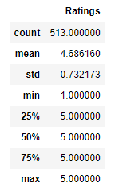
Viz Dump

